Slide 1
Green Computing
Sugata Gangopadhyay

Slide 2
Green Computing Overview (1/2)
Definition: Green computing involves the design, development, and implementation of computing technologies and practices to minimize environmental impact.
Goals:
  Reduce energy consumption.
  Decrease electronic waste.
  Promote sustainability in technology use and manufacturing.

Slide 3
Green Computing Overview (2/2)
Examples:
  Cloud computing to optimize resources.
  Energy-efficient processors and hardware.
  Virtualization for reducing physical server needs.

Slide 4
Moore's Law
Moore's Law is named after Gordon E. Moore, a co-founder of Intel Corporation, who observed in a 1965 paper that the number of transistors on an integrated circuit (IC) doubles approximately every two years while the cost per transistor decreases. This observation has since become a guiding principle for the semiconductor industry and is often extended to imply the exponential growth of computational power over time.

Slide 5
Significance of Moore's Law in Energy-Efficient Computing (1/3)
Miniaturization and Energy Efficiency: As transistors become smaller, they consume less power while providing higher performance. This reduction in size and energy usage has enabled more energy-efficient devices and systems.
Power-Performance Trade-Off: Moore's Law has supported the development of processors that perform more computations per watt of energy, which is critical for applications where energy is constrained, such as mobile devices and embedded systems.

Slide 6
Significance of Moore's Law in Energy-Efficient Computing (2/3)
Thermal Management: Smaller, more efficient transistors generate less heat, enabling the design of compact, high-performance devices without excessive cooling requirements.
Advancements in Battery-Powered Devices:Energy-efficient computing has allowed for longer battery life in portable devices like smartphones, laptops, and IoT devices, supporting the growth of mobile and edge computing.

Slide 7
Significance of Moore's Law in Energy-Efficient Computing (3/3)
Sustainability and Green Computing: By driving innovations in energy-efficient chips, Moore's Law has contributed to reducing the carbon footprint of computing infrastructure, which is important for data centers and large-scale computing environments.
Enabling New Technologies: The energy efficiency enabled by Moore's Law has been pivotal for emerging technologies such as artificial intelligence (AI), quantum computing, and wearable tech, which rely on powerful yet efficient computation.

Slide 8
Conclusion
While Moore's Law has faced challenges due to physical and economic limitations in recent years, its principles have inspired alternative approaches, such as 3D chip architectures, specialized processors (e.g., GPUs and TPUs), and advanced materials, to continue improving energy-efficient computing.

Slide 9
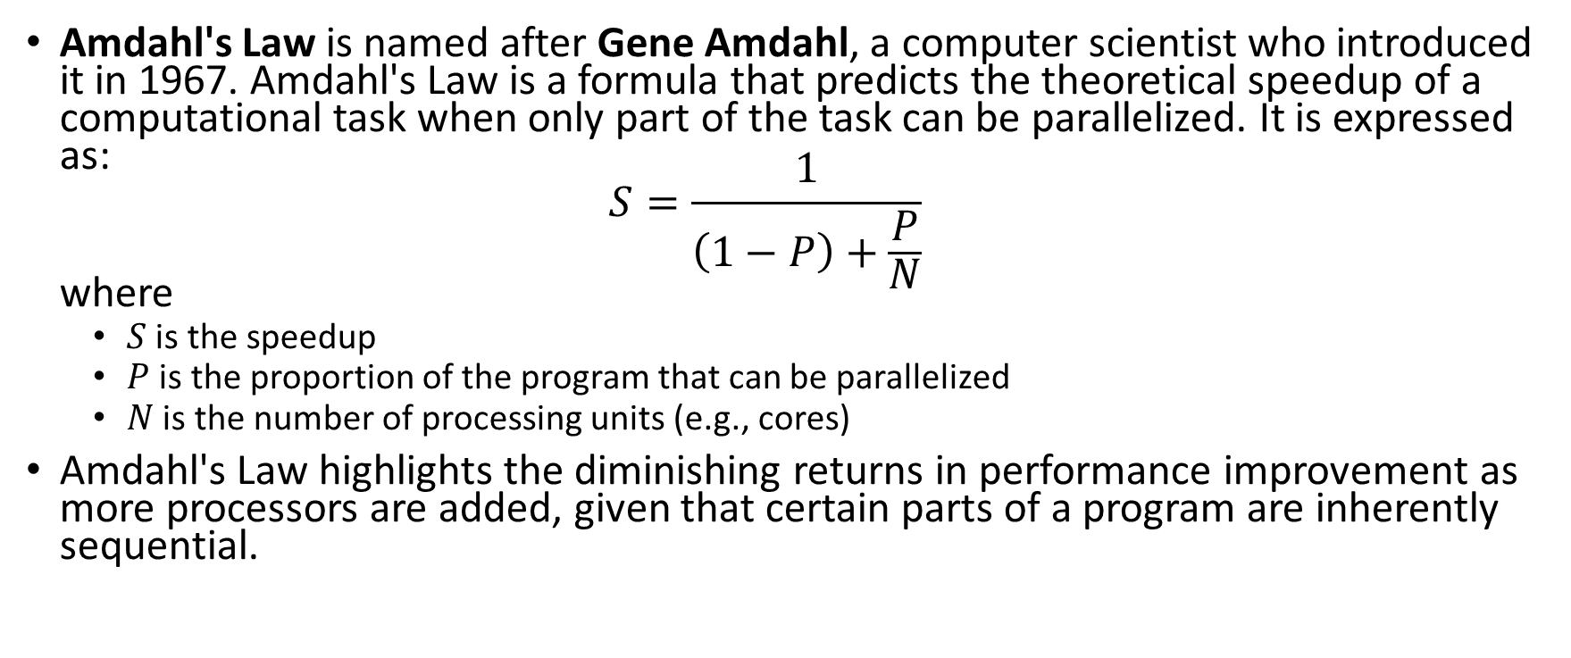
Amdahl's Law
Amdahl's Law is named after Gene Amdahl, a computer scientist who introduced it in 1967. Amdahl's Law is a formula that predicts the theoretical speedup of a computational task when only part of the task can be parallelized. It is expressed as:
$S=\frac{1}{\left(1−P\right)+\frac{P}{N}}$
where
  $S$ is the speedup
  $P$ is the proportion of the program that can be parallelized
  $N$ is the number of processing units (e.g., cores)
Amdahl's Law highlights the diminishing returns in performance improvement as more processors are added, given that certain parts of a program are inherently sequential.

Slide 10
Significance of Amdahl's Law in Energy-Efficient Computing
Optimal Resource Utilization: Amdahl's Law helps identify the diminishing returns of adding more processors or computational resources. By avoiding overprovisioning, it aids in designing energy-efficient systems that do not waste power on redundant parallelism.
Workload Analysis: By understanding the balance between sequential and parallelizable tasks, developers can focus on optimizing energy usage for the most critical parts of the computation.

Slide 11
Significance of Amdahl's Law in Energy-Efficient Computing
Energy-Performance Trade-Offs: Increasing the number of processors increases energy consumption, but Amdahl's Law reveals the point where adding more processors has minimal impact on performance. This understanding leads to better energy-efficient designs.
System Scalability:It guides the development of scalable systems where performance gains are proportionate to energy costs, especially for large-scale parallel systems such as supercomputers and data centers.

Slide 12
Significance of Amdahl's Law in Energy-Efficient Computing
Design of Specialized Hardware: Amdahl's Law informs decisions about integrating specialized accelerators, such as GPUs or TPUs, to optimize parallel portions of workloads while ensuring energy efficiency.
Focus on Sequential Optimization: Since the sequential portion of tasks imposes a hard limit on speedup, optimizing these bottlenecks often yields significant energy efficiency gains.
Energy-Aware Parallelism: Amdahl’s insights encourage careful balancing of the degree of parallelism against energy overheads, particularly in systems with constrained power budgets, such as mobile and edge computing devices.

Slide 13
Significance of Amdahl's Law in Energy-Efficient Computing
Amdahl's Law complements energy-efficient computing by providing a framework for assessing the trade-offs between performance improvements and energy costs in parallel and hybrid computational systems. It emphasizes that smarter design, rather than merely adding resources, is crucial for achieving sustainable computing.

Slide 14
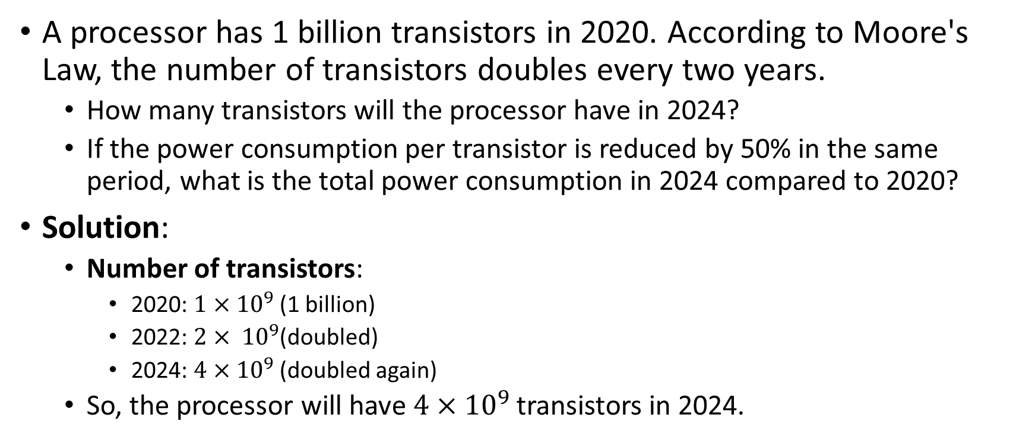
Problem 1 (Application of Moore’s law)
A processor has 1 billion transistors in 2020. According to Moore's Law, the number of transistors doubles every two years.
  How many transistors will the processor have in 2024?
  If the power consumption per transistor is reduced by 50% in the same period, what is the total power consumption in 2024 compared to 2020?
Solution:
  Number of transistors:
    2020: $1×{10}^{9}$(1 billion)
    2022: $2× {10}^{9}$(doubled)
    2024: $4×{10}^{9}$(doubled again)
  So, the processor will have $4×{10}^{9}$transistors in 2024.

Slide 15
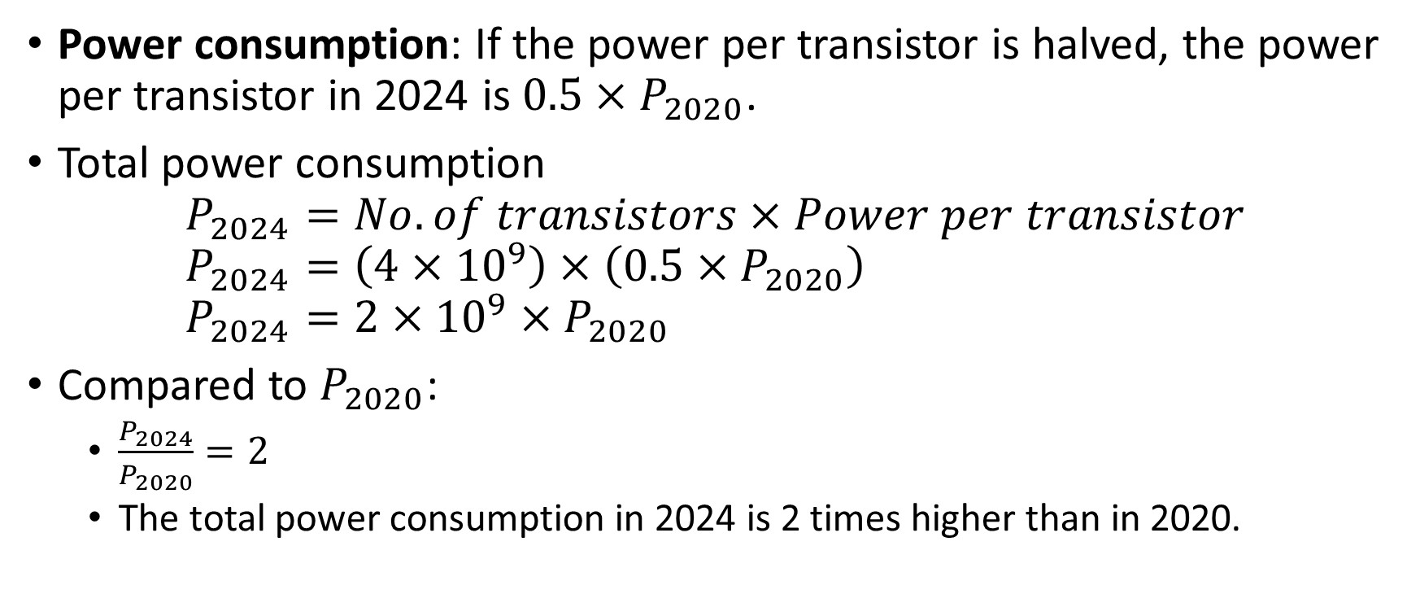
Problem 1
Power consumption: If the power per transistor is halved, the power per transistor in 2024 is $0.5×P_{2020}$.
Total power consumption
$P_{2024}=No. of transistors×Power per transistor$
$P_{2024}=\left(4×{10}^{9}\right)×\left(0.5×P_{2020}\right)$
$P_{2024}=2×{10}^{9}×P_{2020}$
Compared to $P_{2020}$:
  $\frac{P_{2024}}{P_{2020}}=2$
  The total power consumption in 2024 is 2 times higher than in 2020.

Slide 16
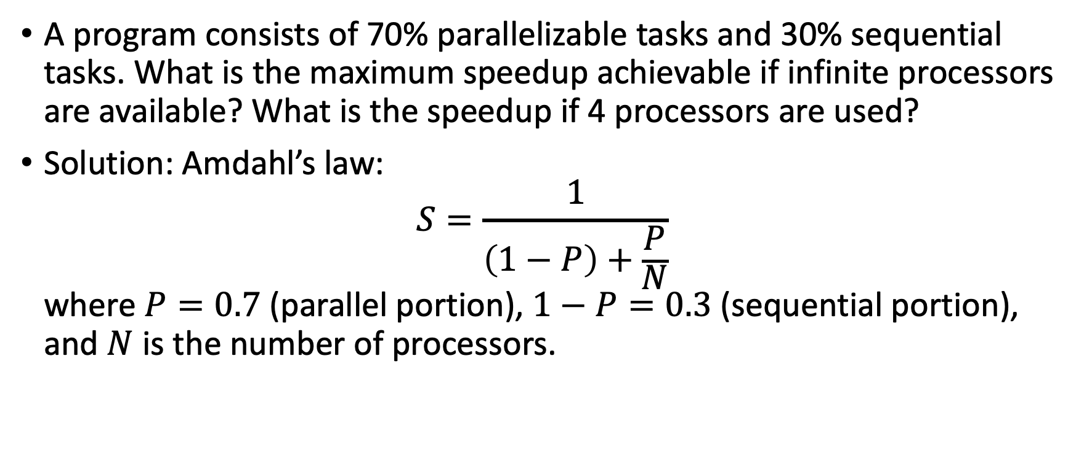
Problem 2 (Application of Amdahl’s law)
A program consists of 70% parallelizable tasks and 30% sequential tasks. What is the maximum speedup achievable if infinite processors are available? What is the speedup if 4 processors are used?
Solution: Amdahl’s law:
$S=\frac{1}{\left(1−P\right)+\frac{P}{N}}$
where $P=0.7$ (parallel portion), $1−P=0.3$ (sequential portion), and $N$ is the number of processors.

Slide 17
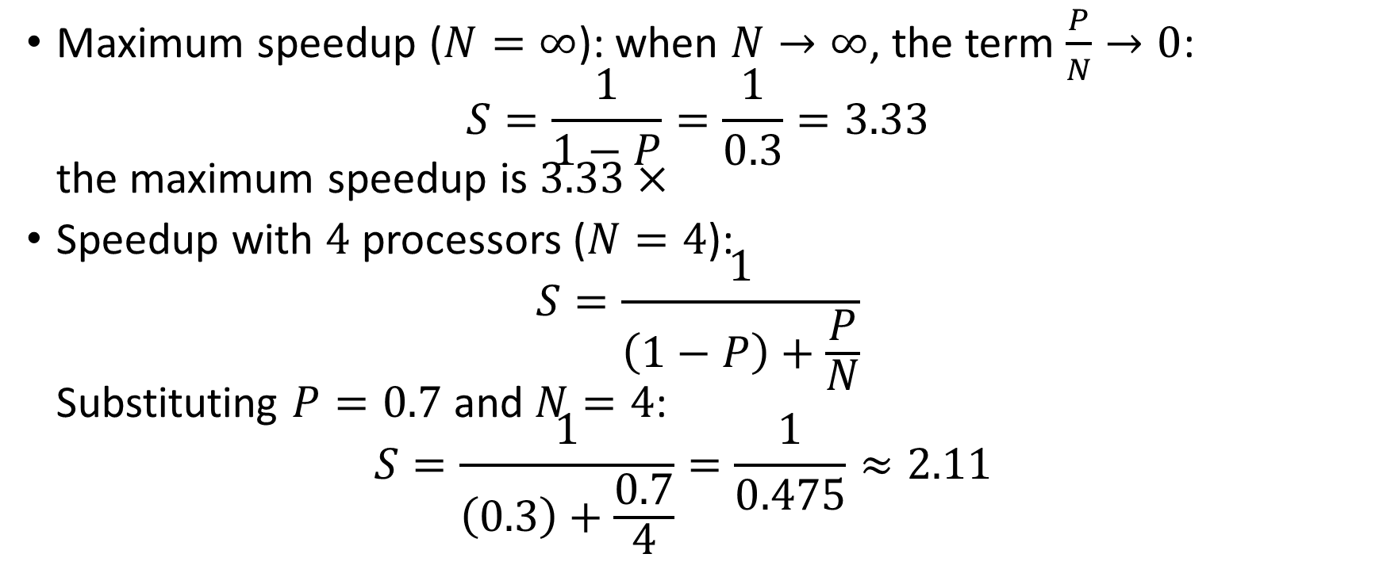
Problem 2 (Application of Amdahl’s law)
Maximum speedup ($N=∞$): when $N→∞$, the term $\frac{P}{N}→0$:
$S=\frac{1}{1−P}=\frac{1}{0.3}=3.33$
the maximum speedup is $3.33×$
Speedup with $4$ processors ($N=4$):
$S=\frac{1}{\left(1−P\right)+\frac{P}{N}}$
Substituting $P=0.7$ and $N=4$:
$S=\frac{1}{\left(0.3\right)+\frac{0.7}{4}}=\frac{1}{0.475}≈2.11$

Slide 18
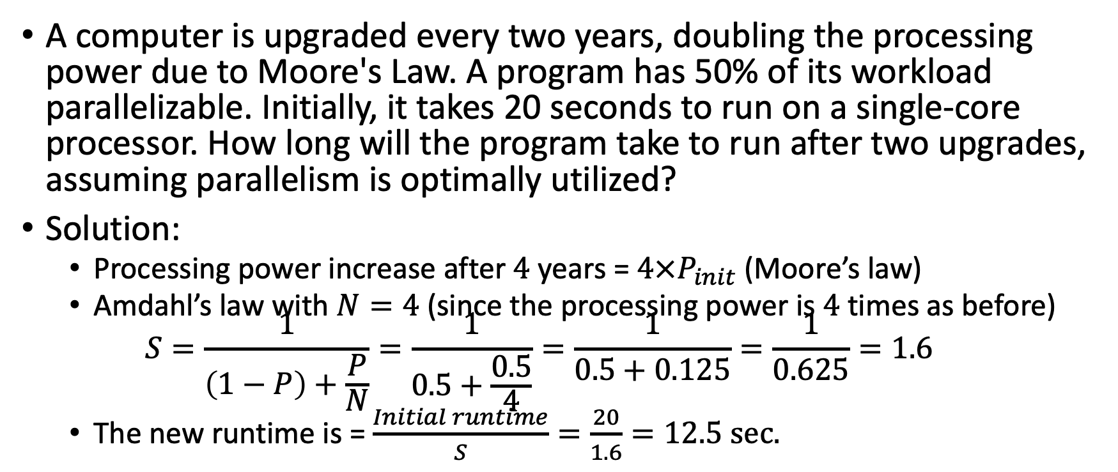
Problem 3: Combining Moore's Law and Amdahl's Law
A computer is upgraded every two years, doubling the processing power due to Moore's Law. A program has 50% of its workload parallelizable. Initially, it takes 20 seconds to run on a single-core processor. How long will the program take to run after two upgrades, assuming parallelism is optimally utilized?
Solution:
  Processing power increase after $4$ years = $4×P_{init}$ (Moore’s law)
  Amdahl’s law with $N=4$ (since the processing power is $4$ times as before)
  $S=\frac{1}{\left(1−P\right)+\frac{P}{N}}=\frac{1}{0.5+\frac{0.5}{4}}=\frac{1}{0.5+0.125}=\frac{1}{0.625}=1.6$
  The new runtime is = $\frac{Initial runtime}{S}=\frac{20}{1.6}=12.5 sec.$

Slide 19
Conclusion
These problems demonstrate the interplay of Moore’s Law (hardware advancements) and Amdahl’s Law (limitations of parallelism) in energy-efficient and high-performance computing.

Slide 20
Dennard's Scaling
Dennard's Scaling, introduced in a 1974 paper by Robert Dennard and colleagues, describes how the power density (power per unit area) of transistors remains constant as they shrink in size, provided voltage and current are scaled proportionally. This principle enabled the rapid miniaturization of transistors while maintaining energy efficiency.

Slide 21
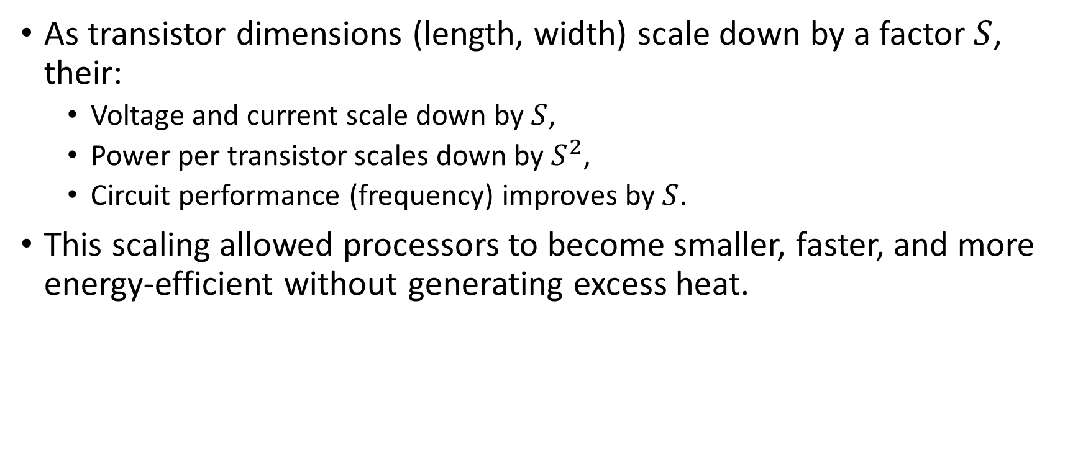
Key points to note
As transistor dimensions (length, width) scale down by a factor $S$, their:
  Voltage and current scale down by $S$,
  Power per transistor scales down by $S^{2}$,
  Circuit performance (frequency) improves by $S$.
This scaling allowed processors to become smaller, faster, and more energy-efficient without generating excess heat.

Slide 22
Application to Energy-Efficient Computing
Improved Energy Efficiency:
  Smaller transistors consume less power, allowing more transistors on a chip while keeping power consumption manageable.
Higher Performance per Watt:
  Faster circuits can operate within the same power budget, boosting computational power without exceeding thermal limits.
Compact Device Design:
  Scaling enables the creation of portable and energy-efficient devices like smartphones and wearables.

Slide 23
Application to Energy-Efficient Computing
Challenges:
  Dennard's scaling broke down around the mid-2000s due to physical limitations, such as leakage currents and heat dissipation issues. This led to the shift toward multicore processors, heterogeneous architectures, and specialized accelerators.

Slide 24
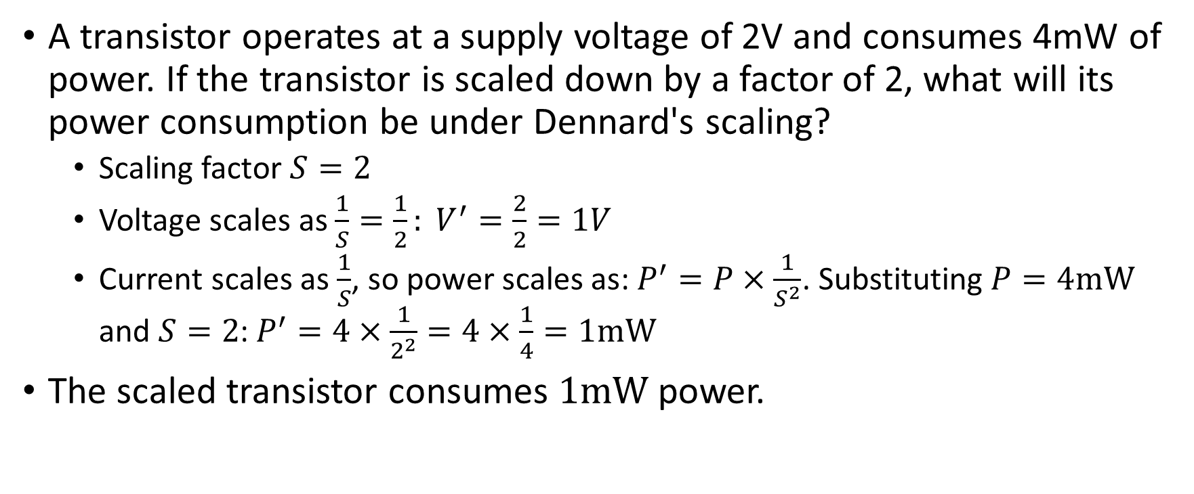
Example 1: Power Scaling
A transistor operates at a supply voltage of 2V and consumes 4mW of power. If the transistor is scaled down by a factor of 2, what will its power consumption be under Dennard's scaling?
  Scaling factor $S=2$
  Voltage scales as $\frac{1}{S}=\frac{1}{2}: V^{′}=\frac{2}{2}=1V$
  Current scales as $\frac{1}{S}$, so power scales as: $P^{′}=P×\frac{1}{S^{2}}$. Substituting $P=4mW$ and $S=2$: $P^{′}=4×\frac{1}{2^{2}}=4×\frac{1}{4}=1mW$
The scaled transistor consumes $1mW$ power.

Slide 25
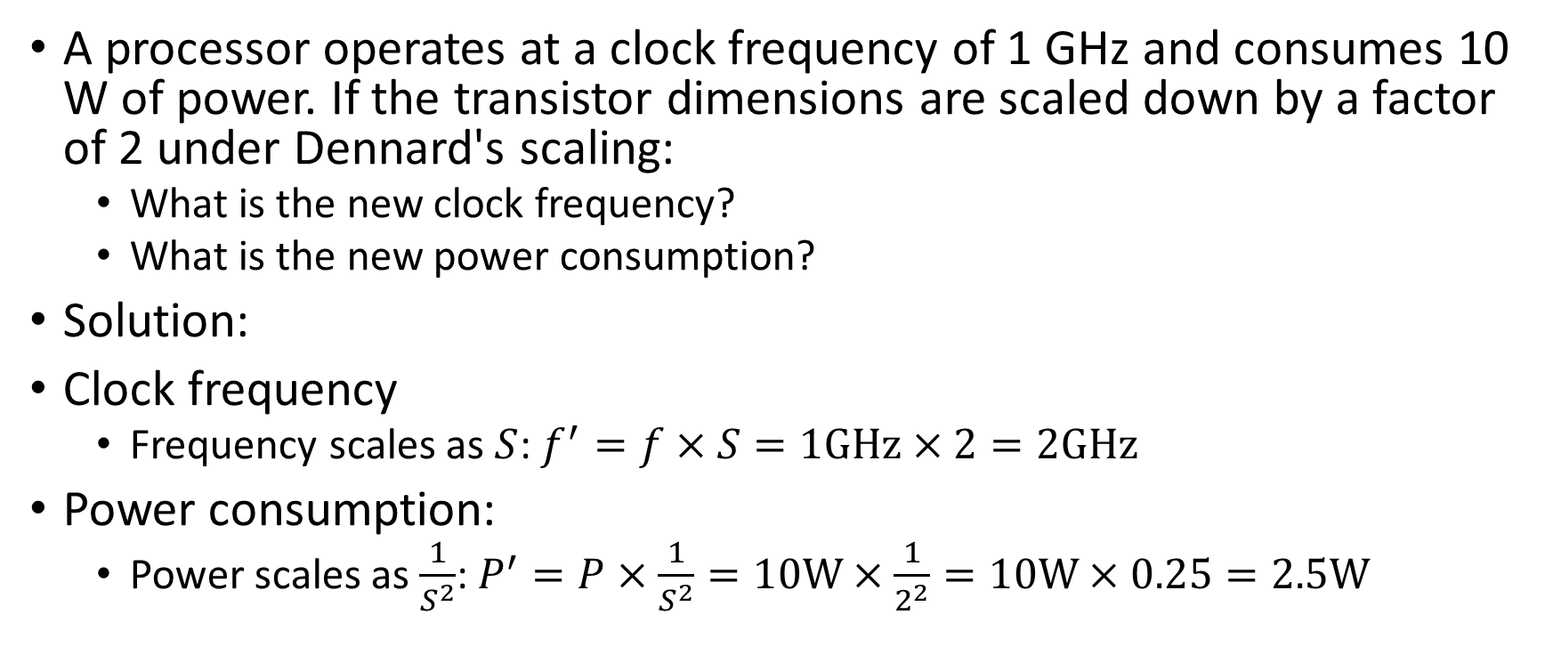
Example 2: Performance Scaling
A processor operates at a clock frequency of 1 GHz and consumes 10 W of power. If the transistor dimensions are scaled down by a factor of 2 under Dennard's scaling:
  What is the new clock frequency?
  What is the new power consumption?
Solution:
Clock frequency
  Frequency scales as $S$: $f^{′}=f×S=1GHz×2=2GHz$
Power consumption:
  Power scales as $\frac{1}{S^{2}}$: $P^{′}=P×\frac{1}{S^{2}}=10W×\frac{1}{2^{2}}=10W×0.25=2.5W$

Slide 26
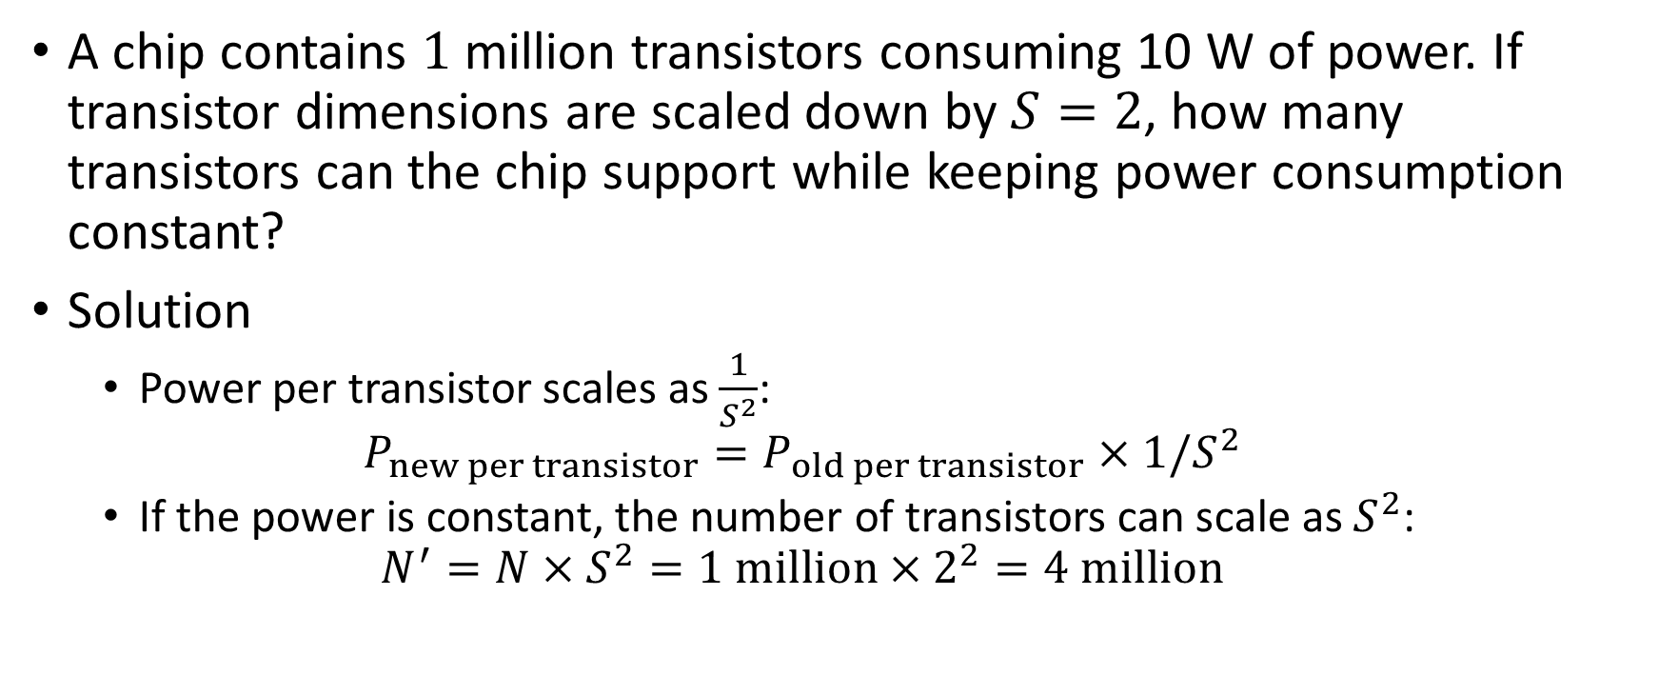
Example 3: Device Density
A chip contains $1$ million transistors consuming 10 W of power. If transistor dimensions are scaled down by $S=2$, how many transistors can the chip support while keeping power consumption constant?
Solution
  Power per transistor scales as $\frac{1}{S^{2}}$:
  $P_{new per transistor}=P_{old per transistor}×1/S^{2}$
  If the power is constant, the number of transistors can scale as $S^{2}$:
  $N^{′}=N×S^{2}=1 million×2^{2}=4 million$

Slide 27
ARM Cortex-A Series (Mobile and Embedded Systems)
Overview:
ARM’s Cortex-A series processors are designed for mobile and embedded systems, emphasizing energy efficiency while maintaining high performance. These processors are used in smartphones, tablets, and IoT devices.
Key Features:
Low Power Consumption: ARM chips use a reduced instruction set computing (RISC) architecture, which leads to lower power consumption compared to complex instruction set computing (CISC) architectures.
Dynamic Voltage and Frequency Scaling (DVFS): ARM processors implement DVFS, allowing them to adjust voltage and frequency according to workload demands, reducing power consumption during idle or low-performance periods.
Big.LITTLE Architecture: ARM introduced the Big.LITTLE architecture, which pairs high-performance cores with low-power cores. The high-performance cores are used for intensive tasks, while the low-power cores handle less demanding operations, optimizing energy usage based on workload.
Impact on Energy-Efficient Computing:
The ARM Cortex-A processors are widely adopted in mobile devices because they provide a balance between power efficiency and performance. The Big.LITTLE design enables intelligent workload distribution, achieving significant energy savings without compromising user experience.

Slide 28
What is ARM?
ARM (originally Acorn RISC Machine, later renamed to Advanced RISC Machines) is a company and architecture that designs RISC (Reduced Instruction Set Computing) microprocessors and related technology. ARM processors are widely used in various devices, from smartphones and tablets to embedded systems, IoT devices, and even laptops. ARM is known for its energy-efficient processors, which provide a balance between performance and power consumption.

Slide 29
Intel’s Low Power Atom Processors (Mobile and Netbooks)
Overview:
Intel's Atom processors are designed specifically for energy-efficient computing in netbooks, tablets, and other mobile devices. The Atom chips are based on Intel's x86 architecture but optimized for low power.
Key Features:
Power-Saving Technologies: Atom processors integrate various power-saving technologies, such as Enhanced Intel SpeedStep Technology (EIST), which adjusts the processor’s voltage and frequency dynamically based on workload.
System on a Chip (SoC) Design: Atom processors often come as SoCs, which combine multiple components (CPU, GPU, memory controller, etc.) onto a single chip, reducing the power overhead from interconnects and enhancing power efficiency.
Low-Voltage Operation: Atom chips are built to run at lower voltages (e.g., 0.8V-1.1V) compared to standard processors, which directly translates into lower energy consumption.
Impact on Energy-Efficient Computing:
Atom processors have enabled the development of energy-efficient devices like netbooks and tablets, offering low power consumption while still supporting the needs of lightweight computing tasks such as browsing, media consumption, and office applications.

Slide 30
NVIDIA’s Volta Architecture (GPUs for Deep Learning and AI)
Overview:
NVIDIA’s Volta architecture (used in Tesla V100 GPUs) focuses on energy-efficient processing for high-performance computing tasks like deep learning and AI. These GPUs have been a game-changer in terms of energy efficiency in specialized computing.
Key Features:
Tensor Cores: Volta architecture includes specialized tensor cores optimized for AI and machine learning tasks. These cores are designed to execute operations with significantly higher throughput, thus improving performance-per-watt.
NVLink: NVIDIA’s NVLink interconnect provides high-bandwidth communication between GPUs, allowing for efficient scaling of workloads. This reduces the need for high power consumption from traditional interconnects like PCIe.
Deep Learning Efficiency: The Volta GPUs are optimized for matrix operations, which are common in machine learning models. By enhancing these operations' energy efficiency, the architecture offers better performance with lower power consumption.
AI-Accelerated Performance: Volta chips support lower precision computations (e.g., FP16, INT8), which require less power than full-precision floating-point operations but still offer high accuracy for AI workloads.
Impact on Energy-Efficient Computing:
The Volta architecture demonstrates how specialized hardware for AI and deep learning can achieve significant performance-per-watt improvements, making large-scale AI research and applications more energy-efficient. These GPUs have made a significant impact on industries like healthcare, finance, and autonomous vehicles.

Slide 31
Google’s Tensor Processing Units (TPUs) for Machine Learning
Overview:
Google designed Tensor Processing Units (TPUs) as custom accelerators specifically for machine learning workloads. TPUs are optimized for high-throughput, low-latency, and energy-efficient execution of machine learning models.
Key Features:
Application-Specific Integrated Circuits (ASICs): Unlike general-purpose processors like CPUs and GPUs, TPUs are custom-designed ASICs that are highly optimized for the specific operations required by machine learning, such as matrix multiplications and convolutions.
Low Power per Operation: TPUs are designed to consume less power per operation than GPUs or CPUs. They achieve this by using specialized circuits and lower precision arithmetic (e.g., 8-bit integer operations) which reduce energy consumption while still delivering excellent performance for ML tasks.
High Throughput: TPUs are designed to maximize throughput for matrix operations that are typical in machine learning models, leading to better energy efficiency for large-scale computations.
Cloud Deployment: Google’s TPUs are available through Google Cloud, allowing for energy-efficient execution of ML models at scale without requiring on-premises infrastructure.
Impact on Energy-Efficient Computing:
TPUs have revolutionized machine learning by delivering high performance with lower power consumption compared to general-purpose processors. They allow for the scaling of AI workloads with a reduced environmental impact, supporting Google's energy-efficient cloud computing goals.

Slide 32
Apple’s M1 Chip (System on a Chip for Personal Computers)
Overview:
Apple's M1 chip, based on ARM architecture, is designed for MacBooks, iMacs, and other Apple devices. The M1 chip integrates CPU, GPU, Neural Engine, I/O, and memory into a single chip, allowing for high efficiency.
Key Features:
Unified Memory Architecture (UMA): The M1 uses a unified memory architecture, which allows both the CPU and GPU to access the same memory pool, reducing the need for separate memory modules and minimizing energy overhead.
Energy-Efficient ARM-Based Design: The ARM architecture used in the M1 chip is known for its low power consumption compared to Intel's x86-based chips. Apple’s focus on power-efficient design provides long battery life in portable devices while maintaining high performance.
Advanced Power Management: The M1 chip uses sophisticated power management techniques, including dynamic power scaling, which adjusts the power and performance of different cores depending on workload demands.
Neural Engine: The inclusion of a dedicated neural engine for machine learning tasks helps offload AI workloads from the main CPU, enabling faster computations with lower power consumption.
Impact on Energy-Efficient Computing:
The M1 chip is a prime example of how energy-efficient architecture can deliver substantial performance gains while keeping power consumption low. Its success in consumer devices like the MacBook Air (with impressive battery life) demonstrates how hardware design can optimize both power efficiency and performance for everyday computing tasks.

Slide 33
Microsoft Project Catapult (FPGAs for Data Centers)
Overview:
Microsoft’s Project Catapult integrates FPGAs (Field-Programmable Gate Arrays) into its data center infrastructure to accelerate cloud-based services, including Bing search and Azure services, with a focus on energy efficiency.
Key Features:
Field-Programmable Gate Arrays (FPGAs): FPGAs are reconfigurable hardware devices that can be optimized for specific workloads. In this case, FPGAs accelerate algorithms like search ranking, compression, and encryption.
Low Power, High Throughput: FPGAs are capable of executing tasks with much lower power consumption than traditional CPUs and GPUs because they are custom-configured for the task at hand.
Integration with Data Centers: FPGAs are used in Microsoft's Azure data centers, allowing for the optimization of energy consumption while maintaining high performance for cloud applications.
Parallelism and Customization: FPGAs are highly parallel, meaning that they can process many tasks simultaneously, and their configurability allows Microsoft to optimize for a wide variety of workloads with minimal energy waste.
Impact on Energy-Efficient Computing:
Project Catapult demonstrates how FPGAs, when integrated into data centers, can provide an energy-efficient alternative to traditional processors for specific workloads, drastically improving performance-per-watt for cloud-based services.

Slide 34
Conclusion
These case studies highlight the diversity of approaches to energy-efficient computing in hardware and architecture. From ARM's mobile chips to Google's specialized TPUs, each example demonstrates how specific hardware optimizations—such as custom processors, dynamic voltage scaling, specialized cores, and system integration—can lead to significant improvements in energy efficiency while still achieving high performance. These advancements are crucial for addressing the increasing energy demands of modern computing, particularly in areas like mobile devices, AI, and cloud infrastructure.

Slide 35
Google’s Strategies for Managing Energy Consumption in Data Centers
https://www.google.com/about/datacenters/efficiency/

Slide 36
Data Center Design and Infrastructure
Efficient Cooling Systems: Google uses advanced cooling techniques such as free cooling (using outside air), liquid cooling, and optimized airflow management.
Custom Hardware: Google designs custom servers that are energy efficient and tailored for their workloads.

Slide 37
Software-Driven Optimization
Workload Management: Google uses machine learning models to predict and manage workloads. This includes adjusting workloads dynamically based on energy availability, such as renewable energy supply.
Scheduling and Optimization Models:
  ILP and related optimization techniques can be applied to allocate workloads to servers and schedule tasks in ways that minimize energy consumption or match renewable energy supply.
  For example, the objective function in an ILP model could minimize total energy consumption subject to constraints like workload deadlines, server capacities, and thermal limits.

Slide 38
Use of Renewable Energy
Energy Matching: Google strives to match its energy consumption with renewable energy supply in real time. This involves sophisticated forecasting models for renewable energy generation (e.g., solar and wind) and aligning data center workloads accordingly.
Battery and Grid Interaction: When renewable energy is not available, Google leverages batteries or purchases energy from grids, potentially applying optimization models to minimize costs and carbon footprint.

Slide 39
ILP and Optimization Approaches
Typical ILP Model Components for Energy Management:
- Decision Variables: Server on/off states, task assignments, cooling system settings.
- Objective Function: Minimize total energy consumption or costs.
- Constraints:
- Capacity constraints for servers and cooling systems.
- Task deadlines and dependencies.
- Temperature and thermal limits.
Variants: Mixed Integer Linear Programming (MILP) models are often used to handle more complex systems involving both continuous (e.g., cooling) and discrete (e.g., server states) variables.

Slide 40
AI-Powered Control Systems
Google has developed AI systems, such as DeepMind, to optimize data center cooling. These systems use reinforcement learning to adjust cooling settings in real time, achieving substantial energy savings.

Slide 41
Open Research and Shared Knowledge
Google has shared insights into its practices through research papers and case studies. While the details of specific ILP models may not be public, general approaches to data center optimization are well-documented in academic and industry literature.
https://www.google.com/about/datacenters/efficiency/

Slide 42
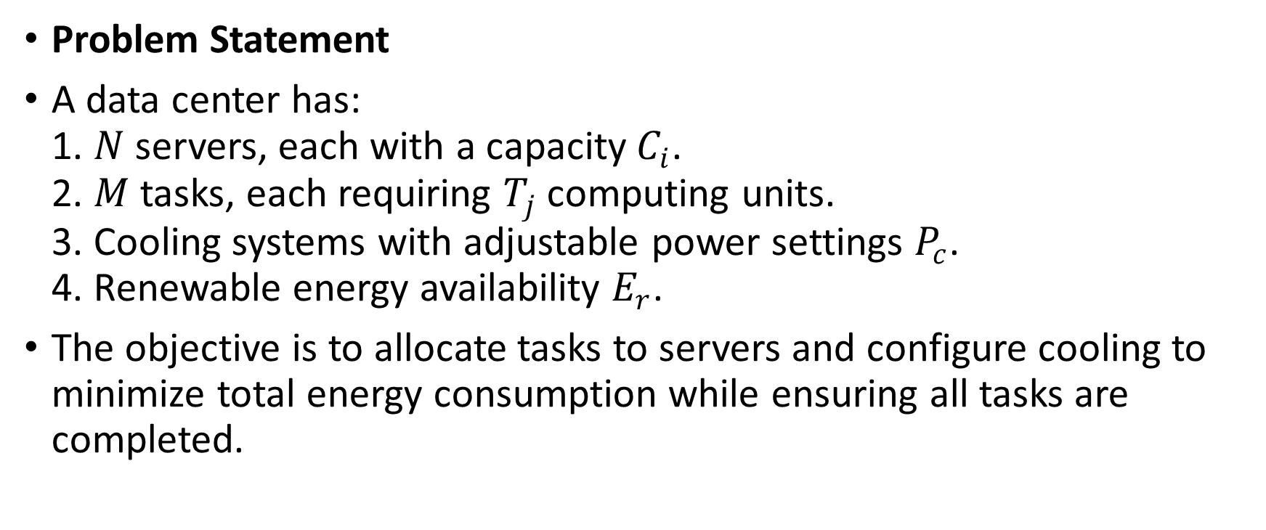
Data Center Energy Optimization Example
Problem Statement
A data center has:
1. $N$ servers, each with a capacity $C_{i}$.
2. $M$ tasks, each requiring $T_{j}$ computing units.
3. Cooling systems with adjustable power settings $P_{c}$.
4. Renewable energy availability $E_{r}$.
The objective is to allocate tasks to servers and configure cooling to minimize total energy consumption while ensuring all tasks are completed.

Slide 43
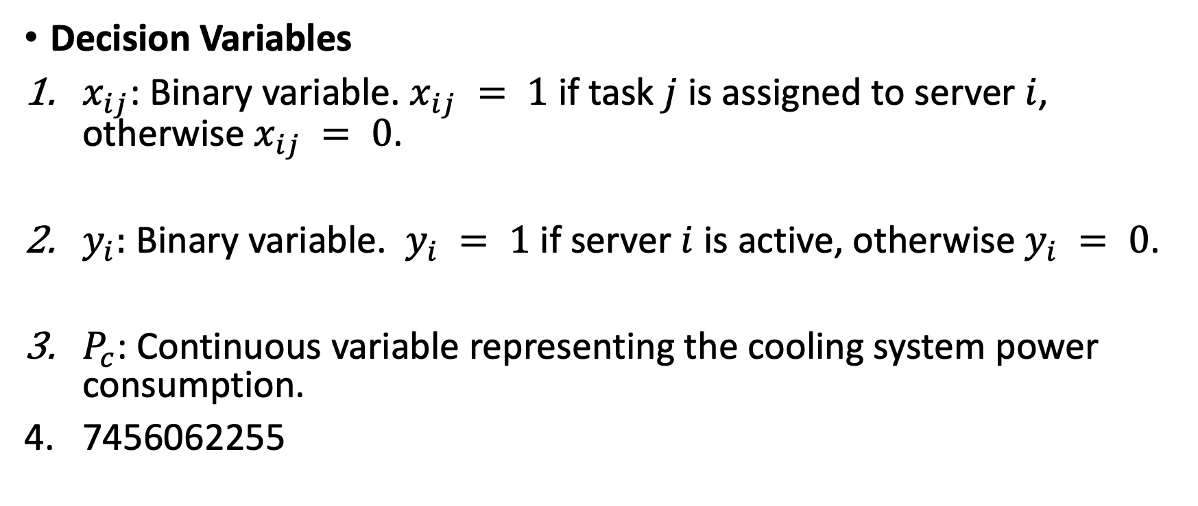
Mathematical Formulation
Decision Variables
$x_{ij}$: Binary variable. $x_{ij} = 1$ if task $j$ is assigned to server $i$, otherwise $x_{ij} = 0$.
$y_{i}:$ Binary variable. $y_{i} = 1$ if server $i$ is active, otherwise $y_{i} = 0$.
$P_{c}$: Continuous variable representing the cooling system power consumption.
7456062255

Slide 44

Objective Function
Minimize total energy consumption:
$E=\sum_{i=1}^{N}{y_{i}⋅E_{s}+P_{c}−E_{r}}$
where $E_{s}$ is the energy consumption of an active server.

Slide 45
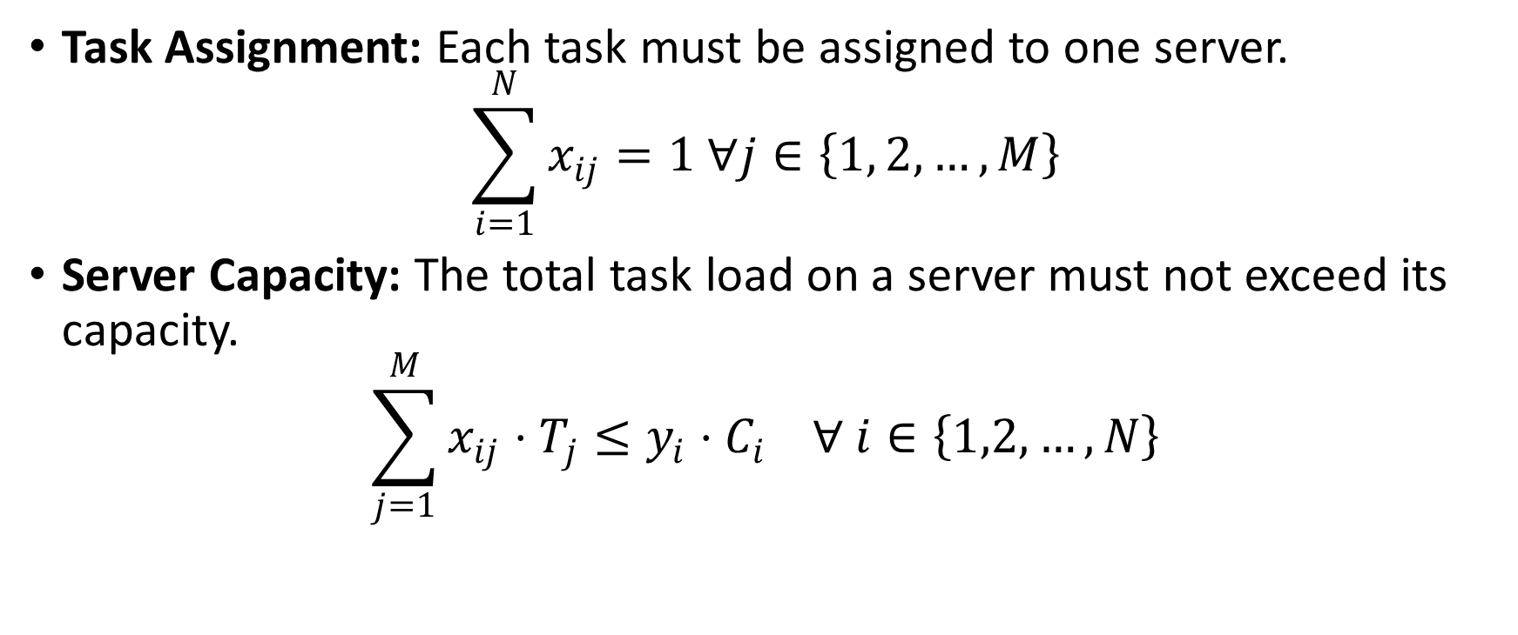
Constraints
Task Assignment: Each task must be assigned to one server.
$$\sum_{i=1}^{N}{x_{ij}=1 ∀j∈\left\{1, 2,…, M\right\}}$$
Server Capacity: The total task load on a server must not exceed its capacity.
$$\sum_{j=1}^{M}{x_{ij}⋅T_{j}≤y_{i}⋅C_{i} ∀ i∈\left\{1,2, …, N\right\}}$$

Slide 46
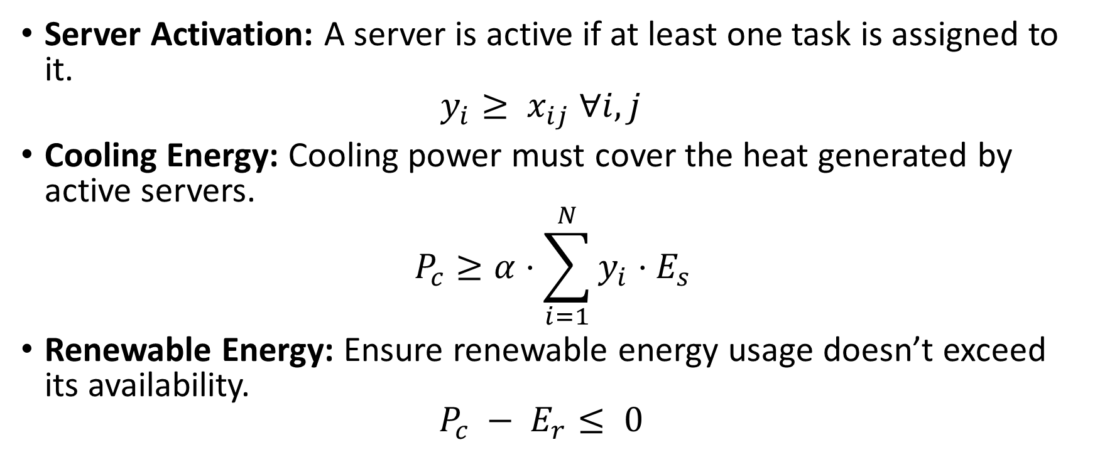
Constraints
Server Activation: A server is active if at least one task is assigned to it.
$y_{i}≥ x_{ij} ∀i, j$
Cooling Energy: Cooling power must cover the heat generated by active servers.
$$P_{c}≥α⋅\sum_{i=1}^{N}{y_{i}⋅E_{s}}$$
Renewable Energy: Ensure renewable energy usage doesn’t exceed its availability.
$P_{c} − E_{r}≤ 0$

Slide 47
Interpretation
This model demonstrates the interplay between:
1. Task allocation to servers.
2. Balancing energy consumption and renewable energy availability.
3. The role of cooling in overall energy efficiency.

Slide 48
Example problem
The data center now has the following parameters:
Energy Consumption:
  Zone 1: Each server consumes 4 kWh.
  Zone 2: Each server consumes 5 kWh.
Computational Capacity:
  Zone 1: Each server provides 8 units of computational power.
  Zone 2: Each server provides 12 units of computational power.
Constraints:
  The total computational demand is at least 96 units.
  The total number of servers activated across both zones cannot exceed 14.
  Due to cooling limitations, Zone 2 can activate at most 7 servers.
  The number of servers in each zone must be integers.
Objective: Minimize the total energy consumption.

Slide 49
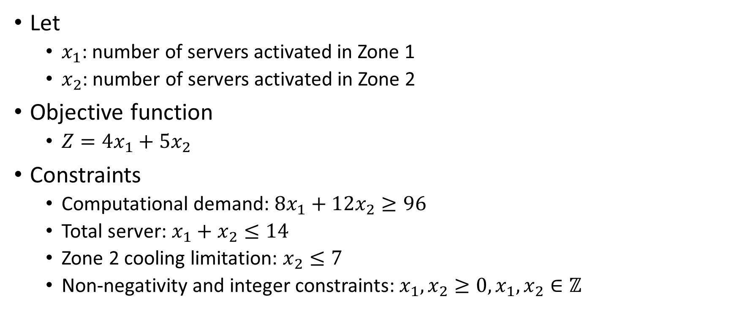
Mathematical Formulation
Let
  $x_{1}$: number of servers activated in Zone 1
  $x_{2}$: number of servers activated in Zone 2
Objective function
  $Z=4x_{1}+5x_{2}$
Constraints
  Computational demand: $8x_{1}+12x_{2}≥96$
  Total server: $x_{1}+x_{2}≤14$
  Zone 2 cooling limitation: $x_{2}≤7$
  Non-negativity and integer constraints: $x_{1},x_{2}≥0, x_{1},x_{2}∈ℤ$

Slide 50
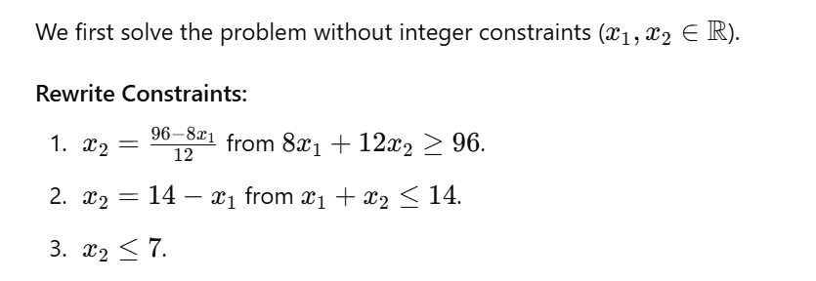
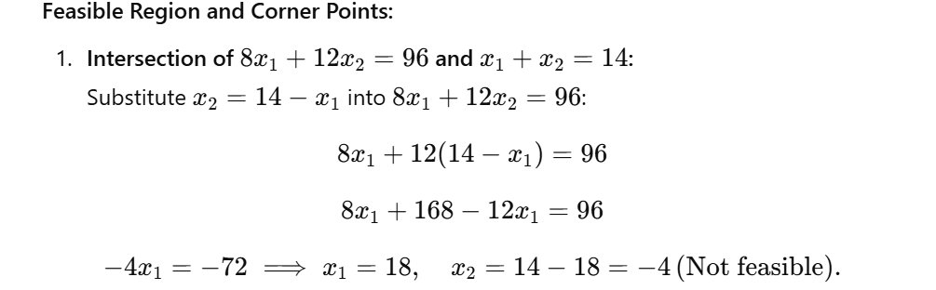
Step 1: Solve the relaxed LP

Slide 51
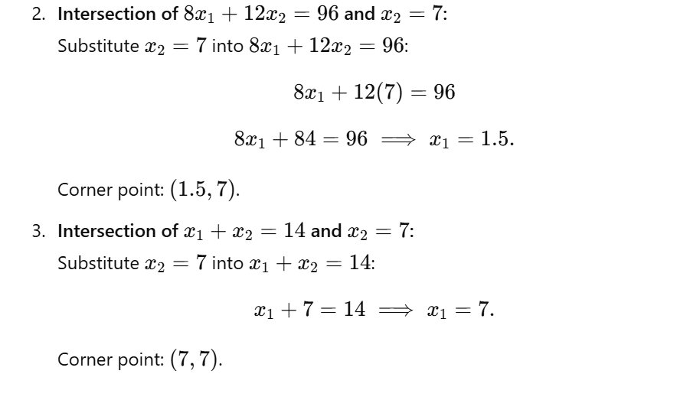
Step 1: Solve the relaxed LP

Slide 52
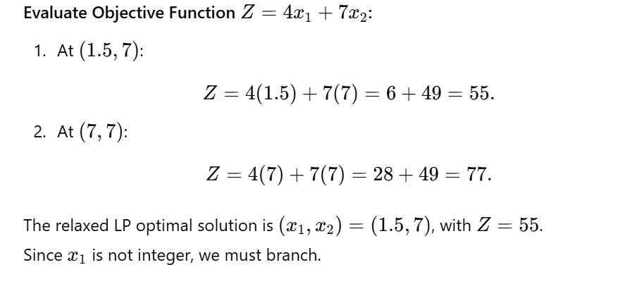
Step 1: Solve the relaxed LP

Slide 53
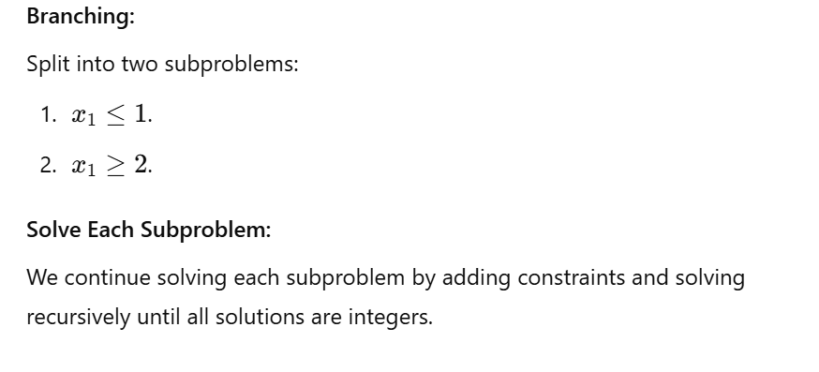
Branch and Bound

Slide 54
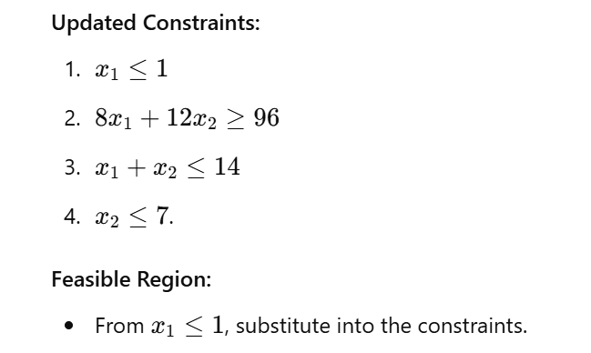
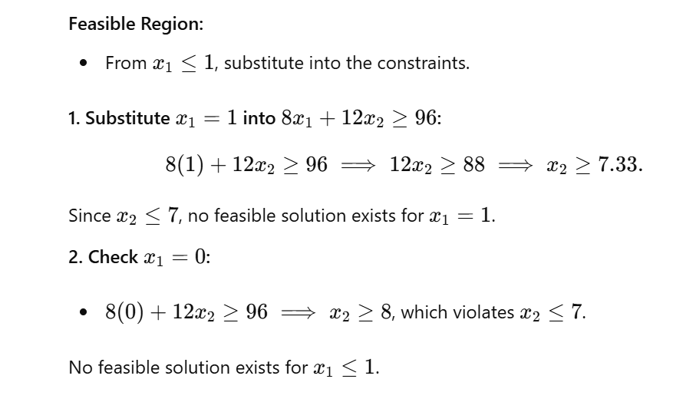
Solve the left branch

Slide 55
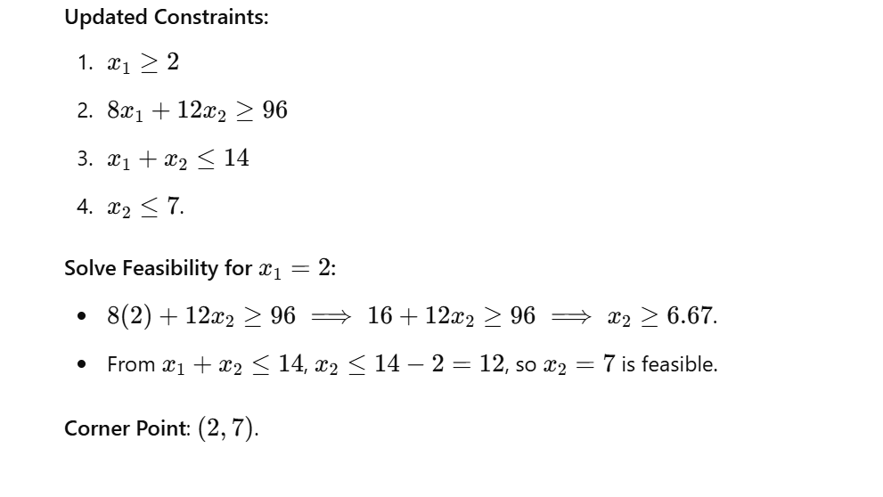
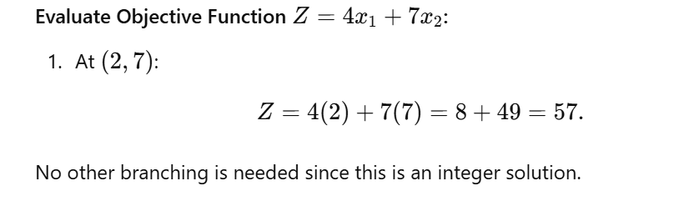
Solve the right branch

